Slide 1
International Conference
Keynote Speech
International Conference
Keynote Speech
2018年10月

Slide 2
Keynote Speech
1. Introduction
1.1. What does keynote mean?
The keynote of a speech is the main theme of a speech or the part that is emphasized the most.
1.2. What is keynote speech / keynote address?
a speech setting forth the keynote, containing a central or the most important idea
1.3. What is a keynote speaker?
a very distinguished speaker introducing the meeting or its subject

Slide 3
Keynote Speech
Tips in mind
2.1. Present your main points one by one in logical order.
2.2. Pause at the end of each point (give people time to take notes, or time to think about what you are saying).
2.3. Make it absolutely clear when you move to another point. For example:
“The next point is that …....”

Slide 4
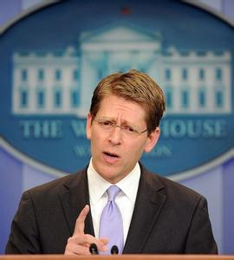
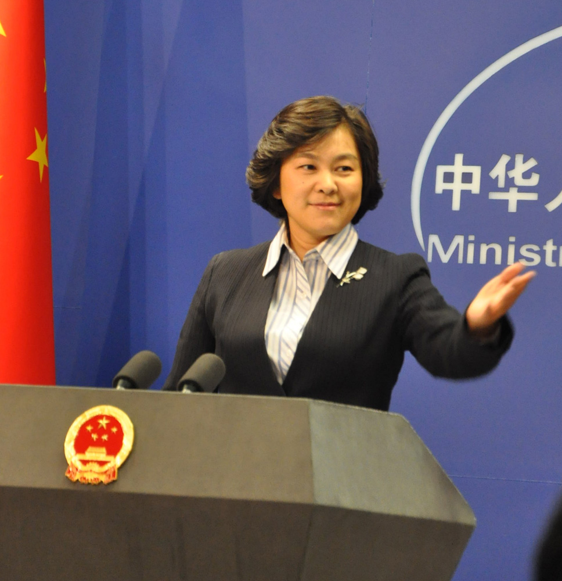
Keynote Speech
Notes: Please pay attention to your body language when making a speech.
★Eye contact:
★ Facial Expressions: Smiling
★ Gestures: A lively speaking style
★ Posture and body orientation: Standing erect and leaning forward

Slide 5
Keynote Speech
How to conclude
3.1. It is very important to leave your audience with a clear summary of everything you have covered.
3.2. It is also important not to let the talk just fizzle out. Make it obvious that you have reached the end of the presentation.
3.3. Summarize the main points again, using phrases like:
“To sum up...”, “So, in conclusion...”
“OK, to recap the main points…”
3.4. Restate the purpose of your talk, and say that you have achieved your aim:
“I think you can now see that...”
“My intention was ..., and it should now be clear that ...”
3.5. Thank the audience, and invite questions:
“Thank you. Any questions?”

Slide 6
Keynote Speech
4. The Voice
4.1. Summarize the main points again, using phrases like:
“To sum up...”, “So, in conclusion...”
“OK, to recap the main points…”
4.2. Restate the purpose of your talk, and say that you have achieved your aim:
“I think you can now see that...”
“My intention was ..., and it should now be clear that ...”
4.3. Thank the audience, and invite questions:
“Thank you. Any questions?”

Slide 7
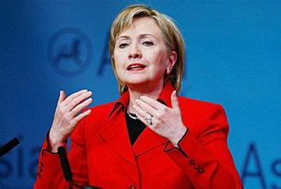
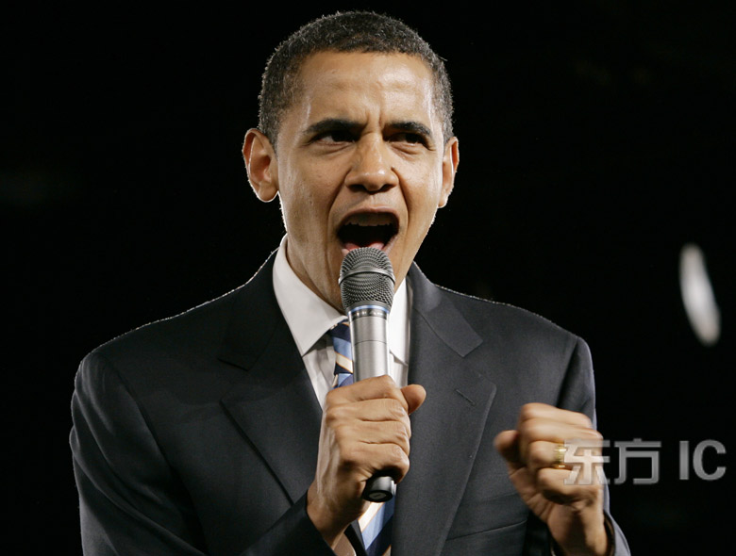
Keynote Speech
4. The Voice
4.4. Two good methods for improving your voice:
★Listen to the native speaker’s speech.
★ Listen to your own voice. Take home recording, and listen!

Slide 8
Keynote Speech
Warm reminder:
5.1. If you are not using a microphone,
speak sufficiently loudly that the furthest member of your audience can hear you clearly.
5.2. If you are using a microphone,
speak at normal volume, but a little more slowly and distinctly
5.3. Regularly sweep your eyes :
left-centre-right and back
front-middle-rear and back

Slide 9
Keynote Speech
5.4. Break your distracting habits:
e.g. “uh”, “you know”, or put our hands in our pockets and jingle our keys too often way to break: Immediate feedback
5.5. Never apologize for your nervousness:
If you don't advertise any weaknesses in your style or content, they probably won't be noticed.
5.6. Have a very clear structure:
A good technique is to tell your audience what you are going to say

